Slide 1
Lecture 1
Introduction into Databases

Slide 2

Introduction into Databases
???
Databases introduction
Three levels of views:
Conceptual view
Database view
Physical view
Conceptual modeling
Relational algebra
SQL Language
Data normalization and Normal forms Data transaction
Physical data storage (introduction) Other database models
Don't panic!

Slide 3
Database, what it is?
„Database is list of records, as are characters, numbers, diagrams,
their systematic structure allows these records search by computer.“
Data = recorded messages
X
Information = message who can change our knowledge (helps us to make decision). Sometimes we can understand the term. Information as row data placed into the context.

Slide 4
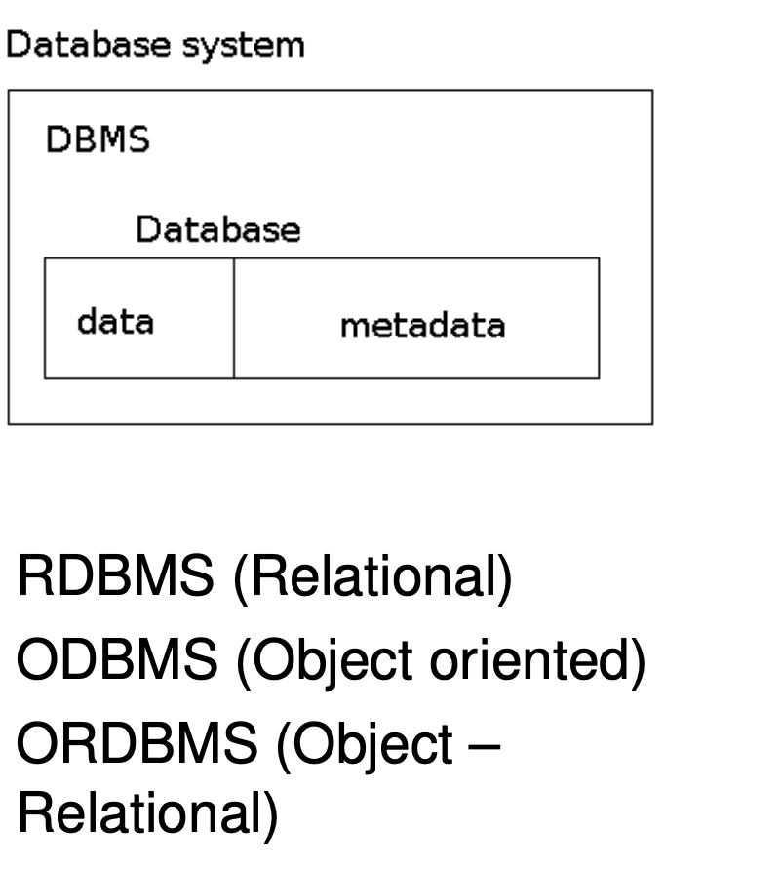
DBS = DBMS + DB
Main paradigm - The data existence in DB doesn’t depend on application programs.
DBS = Database System
DB = Database
DBMS = Database Management System

Slide 5
Database technology
DB technology cares about controlling of big amount (big list), persistent, reliable, shared data.
big amount => for data is not enough operational memory,
persistent => data are preserved from start transformation till end of transformation,
reliable => data can be reconstructed after error ,
shared => data are available for more users:
It’s can be controlled via credentials.
It’s possible to read similar data simultaneously read by more users.

Slide 6
Main sense of database technology
Necessity to split data from application started at sixties (60th), to encapsulate data and simultaneously are use ⇒ establishment of database technology.
Main DB benefits:
Data independence on the application
Effectiveness approach to the data
Faster application development
Data integrity and persistence
Data Management and backup system
Transaction processing
Parallel processing
Recovering after error

Slide 7
RDBMS interface
Communication is ensured by SQL(Structured Query Language).
DDL – Data Definition Language (data definition) => CREATE TABLE teachers (id int, name varchar(255));
DML – Data Manipulation Language (data manipulation and queries) :
inserts => INSERT INTO teachers VALUES (1, ’Pavlicek’);
queries => SELECT name FROM teachers WHERE id = 1;
TCL – Transaction Control Language (transaction processing) => COMMIT; ROLLBACK;
DCL – Data Control Language (permissions) => GRANT INSERT , UPDATE ON teachers TO ’Pavlicek’;

Slide 8
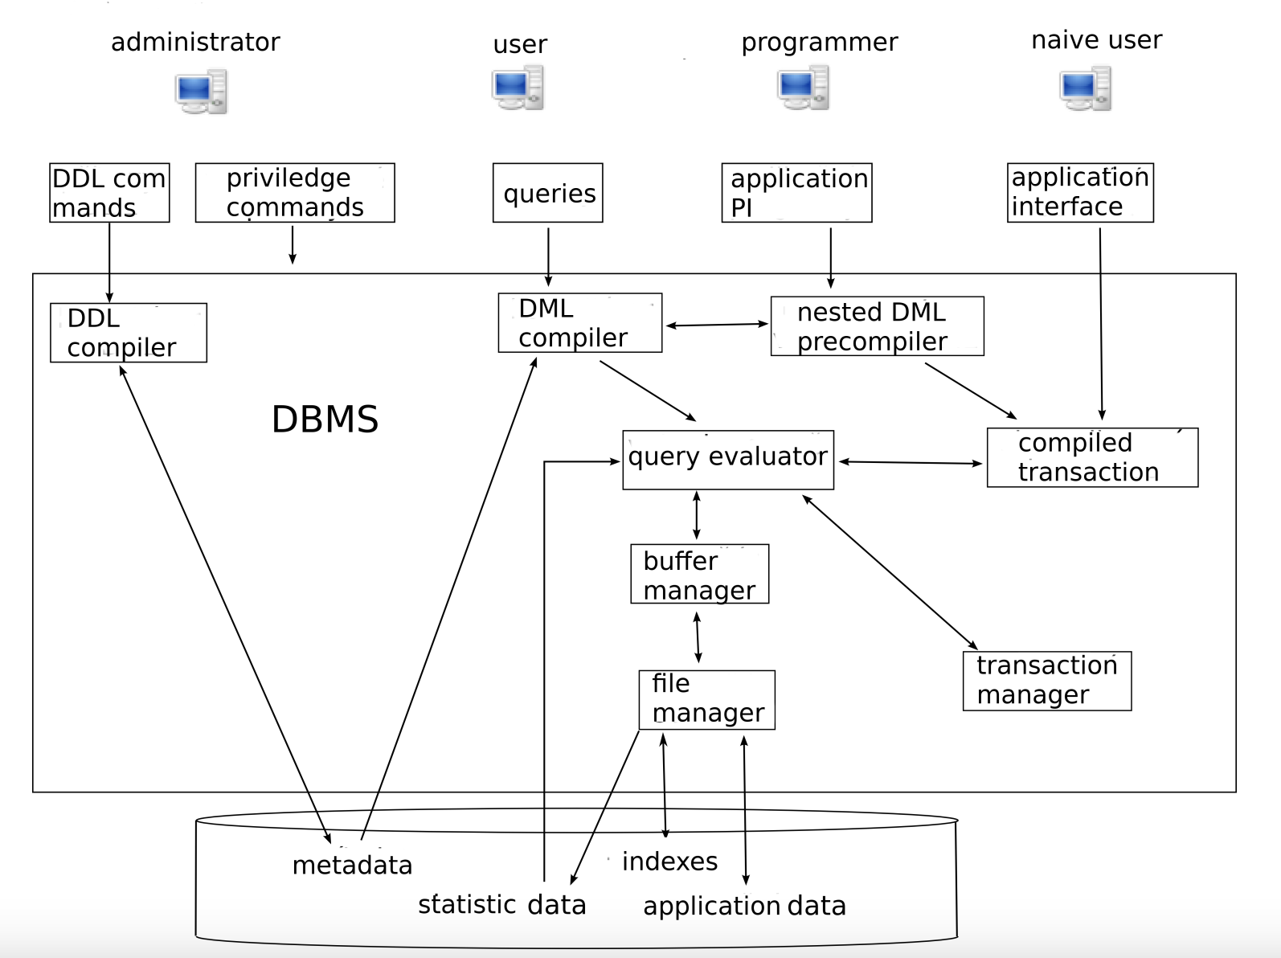
DBMS architecture

Slide 9
Important term (remember them)
Database, why we use it, database technology benefits.
DBS, DBMS, data dictionary (metadata).
DB architecture, typical users.

